Slide 1
SAP BTP Build Apps Training
Day 9
Anubhav Oberoy
www.AnubhavTrainings.com
Follow excellence with sheer passion

Slide 2


DISCLAIMER
The training content and delivery of this presentation is confidential, and cannot be recorded, or copied and distributed to any third party, without the written consent of Anubhav Trainings

Slide 3
Agenda – Day 9
01
Create user destination
02
Publish process
03
Call process from Build apps

Slide 4
Scenario
https://help.sap.com/docs/build-process-automation/sap-build-process-automation/configure-sap-build-process-automation-destinations

Slide 5

What We Did
Let’s Summarize

Slide 6

www.anubhavtrainings.com
Thank You
End of Day 9

Slide 7

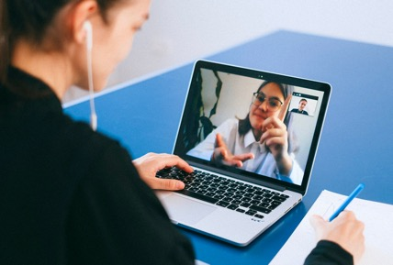
We’re committed to empower you to be
#FutureReady
through powerful training solutions.
We build the workforce of the future.
250+
Corporate Clients
30,000+
Learners Trained
25000+
Learners Placed
FREE WEBINARS
Sign up for free webinars with industry experts every fortnight!
Enroll Now!
Contact us today!
https://anubhavtrainings.com

